Slide 1

ML/AI model evaluation platform
Milestone 1: Inception
Plataforma de avaliação de modelos ML/AI
Course: “Projeto em Informática”
Supervisor: Prof. Mário Luís Pinto Antunes
2023-02-28
Team:
Diogo Oliveira Magalhães 102470
Rafael Fernandes Gonçalves 102534
Leonardo Almeida 102536
Emanuel Gaspar Marques 102565
Pedro Henrique Figueiredo Rodrigues 102778

Slide 2

Context
The need to process large amounts of data has been one of the main reasons for the mass development of intelligent systems.
Machine Learning (ML) algorithms are often applied to optimise multiple real-life scenarios, leading to cost saving and increased productivity.
Advances in storage and processing technologies (e.g. cloud computing) have made it easier to collect, store and transform information.
Machine Learning
Increasingly, machine learning methods are applied to
optimise multiple real-life scenarios.
From classifying people, objects and actions,
through intelligent conversation bots to complex regression systems capable of dealing with the financial market.
Teaching these methodologies has several difficulties, due to the complexity of the area itself, the high number of library and process combinations and the difficulty of evaluating a model. In this case we are especially interested in the validation of models
REVER (menos texto)
Notes:
Vivemos numa nova era, onde todos estamos conectados = + dados
Nova geração
Pc + phone + grandes volumes de dados
Exempo de “increased productivity”: suppy chains
Cada vez mais são aplicados métodos de aprendizagem máquina (Machine Learning) para
otimizar múltiplos cenários da vida real. Desde classificação de pessoas, objetos e ações,
passando por bots de conversação inteligente até a sistema de regressão complexos capazes de lidar com o mercado financeiro.
O ensino destas metodologias tem várias dificuldades, pela complexidade da área em si, pelo
elevado número de biblioteca e combinações de processos e pela dificuldade de avaliação de um modelo. Neste caso estamos especialmente interessados na validação dos modelos

Slide 3
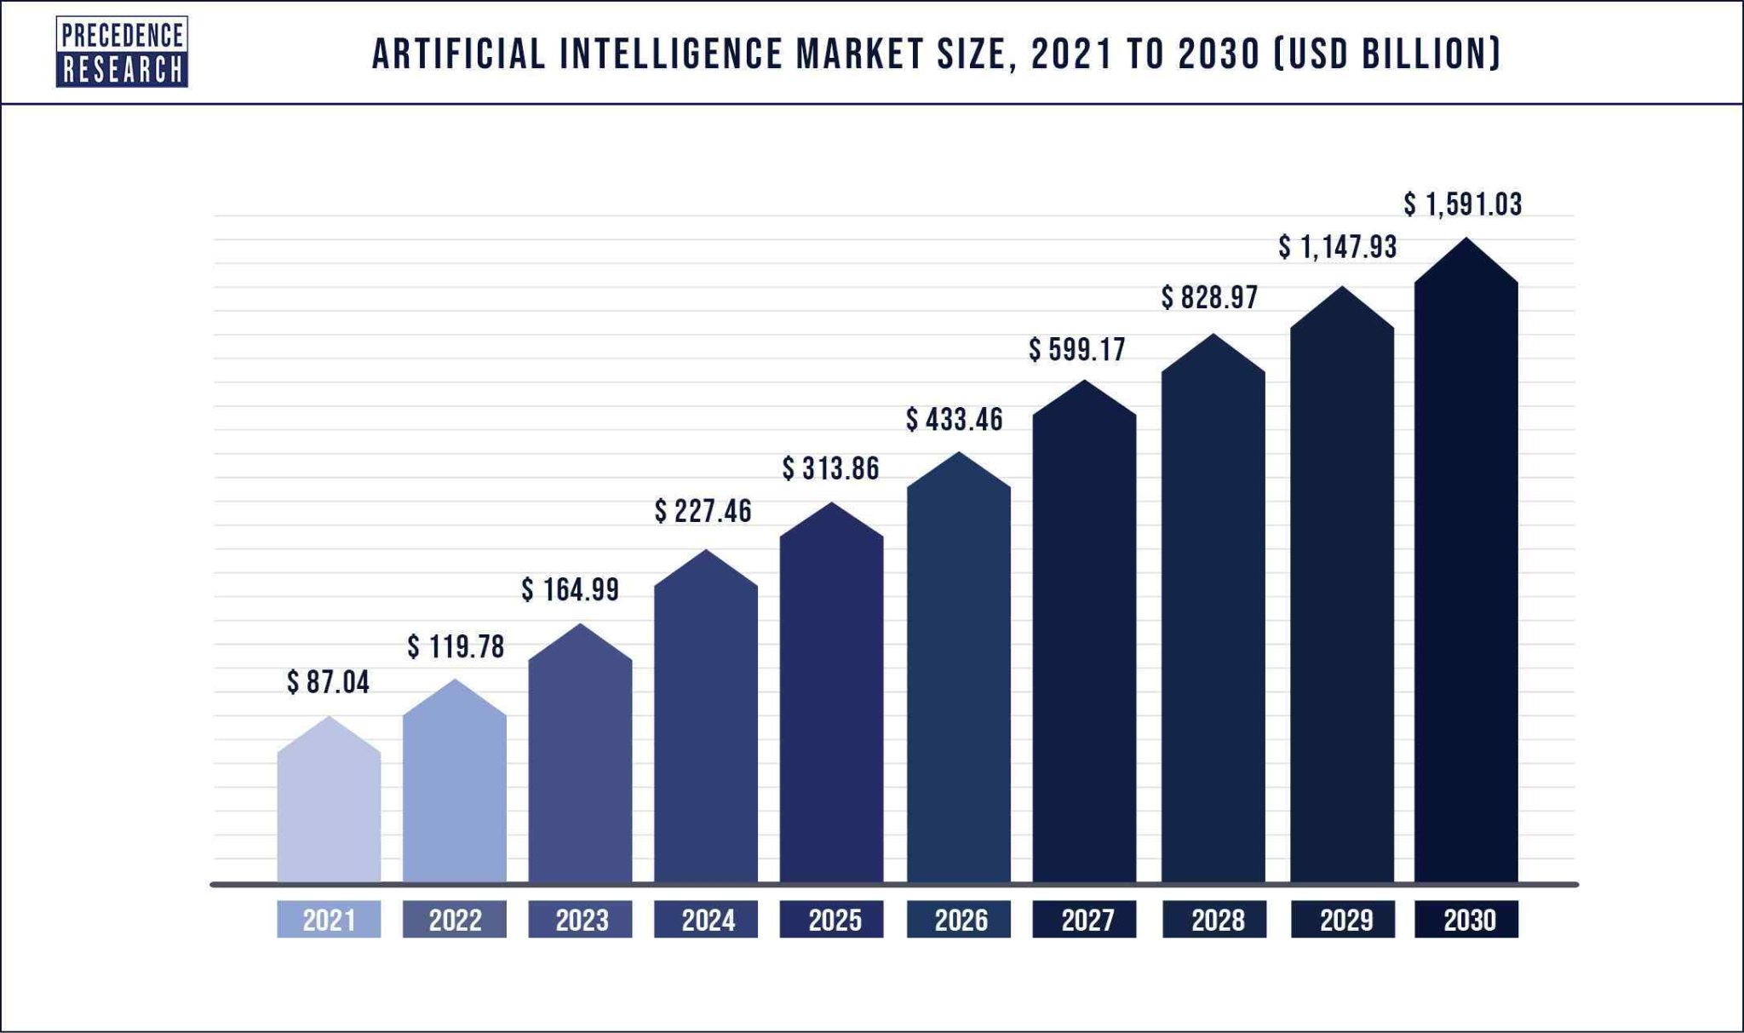
Why is so important to promote a better ML/AI education?
Source: Precedence Research. (2023). Artificial Intelligence (AI) Market (Report No. 1635).
Increasingly, machine learning methods are applied to
optimise multiple real-life scenarios.
From classifying people, objects and actions,
through intelligent conversation bots to complex regression systems capable of dealing with the financial market.
Teaching these methodologies has several difficulties, due to the complexity of the area itself, the high number of library and process combinations and the difficulty of evaluating a model. In this case we are especially interested in the validation of models
REVER (menos texto)
Notes:
É imperativo ensinar as novas gerações a dominar IA/ML.

Slide 4
Applications of Machine Learning
Medical diagnosis
Product recommendations
Fraud detection
Virtual Assistant
M L
Autonomous driving
Stock market trading
Image recognition
Speech recognition

Slide 5
Problems
Complexity of evaluating Machine Learning models
Difficult tracking of students’ progress
Teachers take a long time grading students work
Poor comparison between students

Slide 6
Goals
01
02
Develop a ML/AI model evaluation platform
Enhance the ML and AI learning process
Help students improve their ML knowledge, specially develop good machine learning models
Help teachers improve the ML teaching process
Motivate and prepare students for future challenges that require ML/AI techniques
Notes:
goals
Ver openup

Slide 7
Expected Results
Integration with UA IDP
Authentication method using UA IDP since target audience are UA people
Grouping Students by the teacher
Teachers should be able to create, modify and delete classes
Exercices creation
Teachers can upload datasets and create exercises with limited attempts, deadlines and specific evaluation methods.
Students engagement
Students may access proposed exercices and submit a solution to them and compare results with other students

Slide 8
Risks
UA IDP may fail or go down leaving our system unusable
Datasets integrity
Students willingness to cheat
Requirements can change during development process
Lack of testing
Users may not adopt the software
Notes:
Risk management is an integral part of project management. Although often overlooked, it is crucial to identify as many risks to your project as possible and prepare to mitigate those risks.
Here are some examples of common project risks:
Time and cost estimates are too optimistic.
Customer review and feedback cycle too slow.
Unexpected budget cuts.
Unclear roles and responsibilities.
The project team obtained no stakeholder input.
Not clearly understanding stakeholder needs.
Stakeholders change requirements after the project has started.
Stakeholders add new requirements after the project has begun.
Poor communication results in misunderstandings, quality problems and rework.
Lack of resource commitment or required skillset.

Slide 9

Tasks
Build front-end interface
(2 people)
Build back-end ML evaluation model
(2 people)
Talk to domain experts
Talk to STIC administrators in order to integrate UA IdP onto our platform.
(1 person)
Prototyping and usability tests

Slide 10

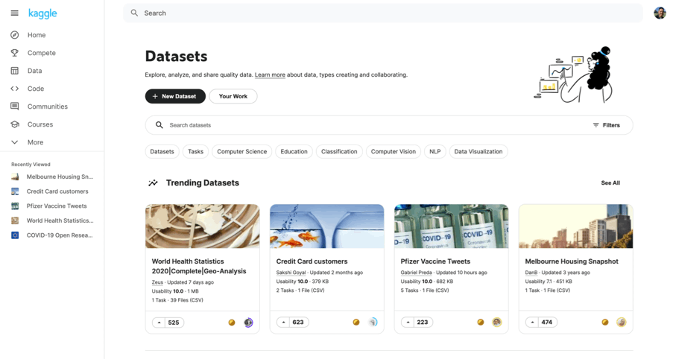
Related work
What is it?
Why don’t we just use kaggle?
Notes:
O Kaggle é uma plataforma líder em ciência de dados que ajuda cientistas de dados, engenheiros de machine learning e entusiastas da tecnologia em todo o mundo a explorar conjuntos de dados, compartilhar conhecimentos e participar de desafios de ciência de dados desde 2010.
A utilização deste serviço tem alguns problemas a nível académico como:
O website não serve apenas para a resolução de exercícios e competições, mas também tem diversas outras funções (como referido anteriormente) As competições entre alunos são difíceis de monitorar, pois não é possível limitar quem pode aceder às competições, ou seja, os professores não conseguem visualizar o real estado dos seus alunos de forma simples e fácil.

Slide 11
Calendar
Our approach will be iterative and incremental (OpenUP).
4 milestones Open up
Sprints
Tasks e entregas estão associadas as M
Datas
M1
M2
M3
M4
Inception
Elaboration
Construction
Transition
1
2
3
4
5
6
7
8
9
10
11
12
13
14
Sprints
Notes:
(está simples que é para avançar rápido)

Slide 12
Inception
Requirements
Objectives
Key functionalities
Calendar
Vision
Risks
M1
M2
M3
M4
Inception
Elaboration
Construction
Transition
1
2
3
4
5
6
7
8
9
10
11
12
13
14
Sprints
Notes:
LEO

Slide 13
Elaboration
Architecture
Requirements enhancement
Mitigate risks
M1
M2
M3
M4
Inception
Elaboration
Construction
Transition
1
2
3
4
5
6
7
8
9
10
11
12
13
14
Sprints
Notes:
LEO

Slide 14
Construction
Prototype
Usability tests
Product development
Feedback analysis
M1
M2
M3
M4
Inception
Elaboration
Construction
Transition
1
1
2
3
3
4
4
5
6
7
8
9
10
11
12
13
13
14
14
Sprints
Notes:
LEO

Slide 15
Transition
Minor adjustments
Product developed
Deployment
Documentation finished
M1
M2
M3
M4
Inception
Elaboration
Construction
Transition
1
2
3
3
4
4
5
5
6
6
7
7
8
8
9
9
10
10
11
11
12
12
13
14
Sprints
Notes:
LEO

Slide 16
Communication plan
Weekly face-to-face meeting
Website with important deliverables
Slack group with supervisor
Atlassian Jira
GitHub
Notes:
LEO

Slide 17
Resources
https://www.projectsmart.co.uk/project-planning/project-planning-step-by-step.php
https://www.precedenceresearch.com/artificial-intelligence-market
https://slidesgo.com/theme/retato-slideshow#position-38&results-1357
https://storyset.com
https://www.utm.mx/~caff/doc/OpenUPWeb/index.htm

